Slide 1
Week 5-6 (Semester2)

Slide 2
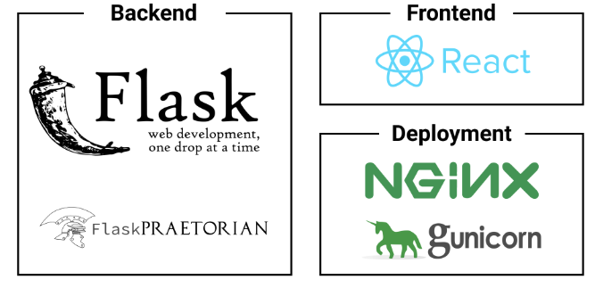
Deployment
This is server architecture. MySQL(database) server connect with Flask backend and it use gunicorn for backend.
Then for react frontend, use nginx for web server.

Slide 3
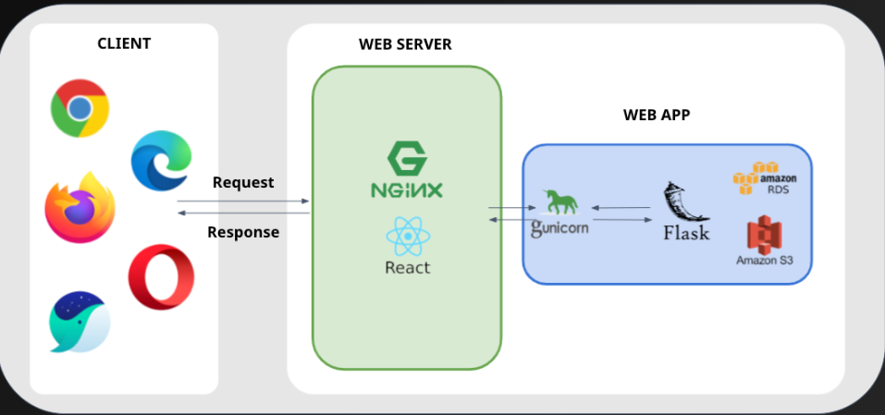
Server Architecture

Slide 4
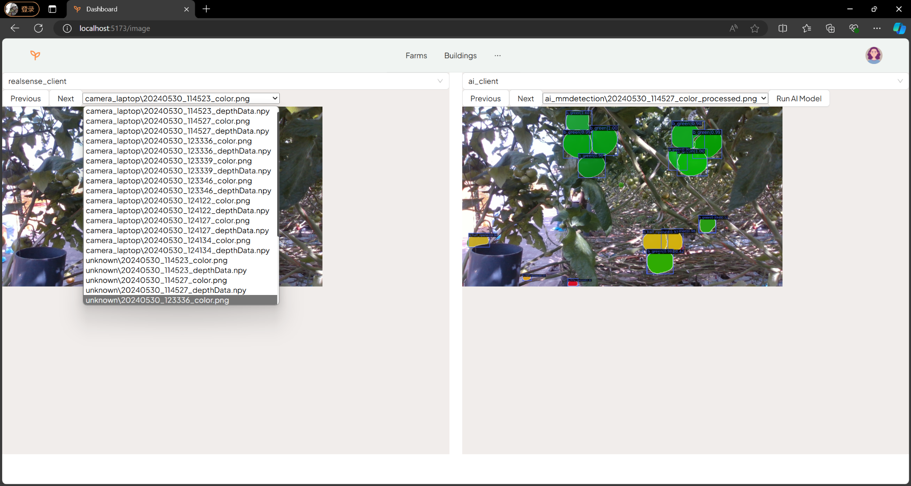
Backend Code Update

